Slide 1
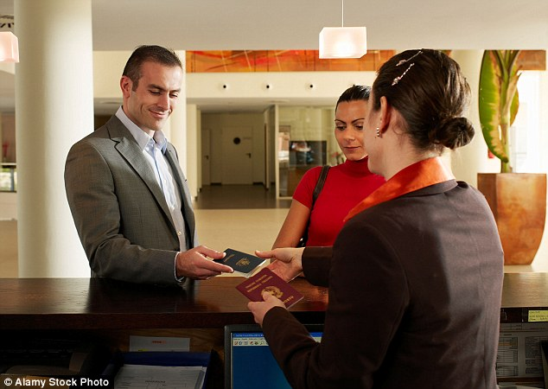
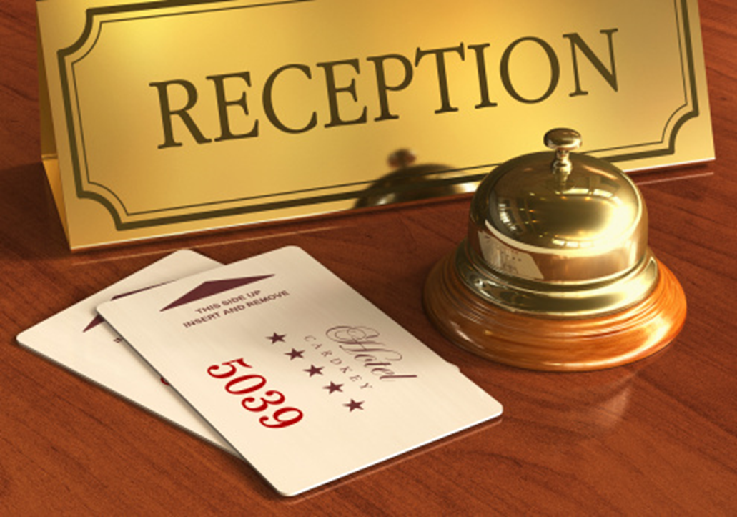

Manual Process
Problem statement
Guest visits hotel reception, Shows receipt/proof of booking
Room check in is done through manual process
Shows valid proof of identity and verify credit card for guarantee
Collects key, enters the room
Stay at the hotel for the duration booked
Pay the invoice amount on checkout
Image Source : Alamy Stock Photo

Slide 2

Proposed Solution
Hotel rooms to be booked using an online portal – web/app
The portal authenticates guest’s proof of identity using UID (India) or SSN (USA) or any other valid identity proof
After the payment, unique QR code is generated
At the time of check in, guest just have to enter the hotel. A hotel kiosk scanner reads the QR code and authorize room access

Slide 3

Business Impact
Automated solution
Valid ID authenticated and authorized QR
Huge cost savings, how much value Hassle free hotel room check in
Image Source : Condé Nast

Slide 4

Prototype Demo
A web app is created that demonstrates hotel booking.
The web app demonstrates proof of concept for identity verification.
After booking, the web app generates a QR code – the key
A raspberry pi is programmed to scan QR code.
The board & the camera module acts as a device to demonstrate unlocking of door.

